Slide 1
Programming Fundamentals
By
Shazmeen Batool

Slide 2
Previous Lecture
Multi-way if else
Nested if else
Logical Operators

Slide 3
Today’s Lecture
Ternary Operator
Switch in C++

Slide 4
Ternary Operator
A ternary operator evaluates the test condition and executes a block of code based on the result of the condition.
Syntax:
condition ? expression1 : expression2;
Here, condition is evaluated and if condition is true, expression1 is executed. And, if condition is false, expression2 is executed.
The ternary operator takes 3 operands (condition, expression1 and expression2). Hence, the name ternary operator.

Slide 5
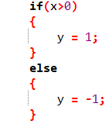
Ternary Operator
The above code can be written as follows using ternary operators.

Slide 6
Activity
Ask user to enter two numbers assign greater number to max
max = num1 > num2 ? num1 : num2;

Slide 7
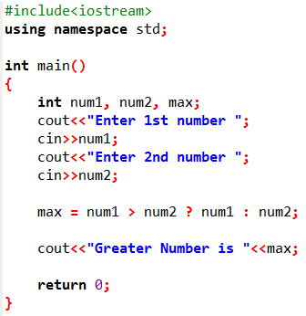

Output

Slide 8
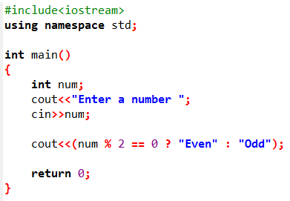

Activity
Ask user to enter a number find if it is even or odd using ternary operators.
Output

Slide 9
Switch Statement
A switch statement executes statements based on the value of a variable or an expression.
The switch selection statement is called a multiple-selection statement because it selects among many different actions (or groups of actions).

Slide 10
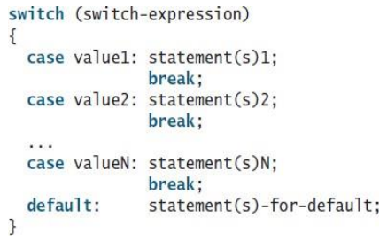
Switch Statement
Syntax

Slide 11
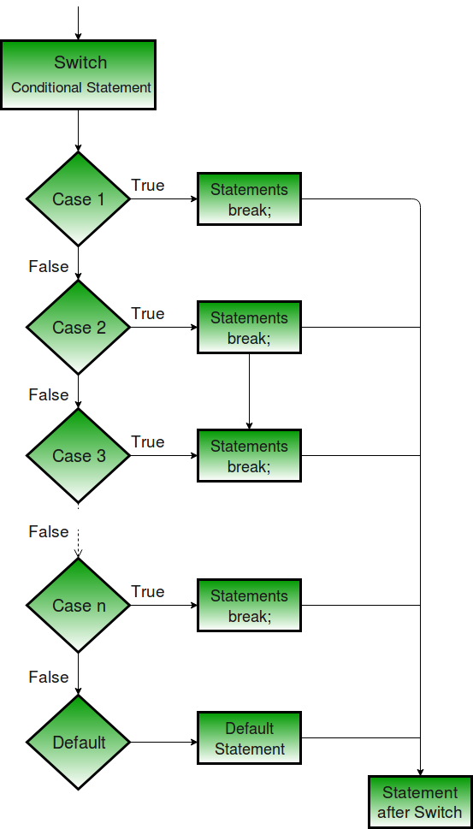

Slide 12
Switch Statement
The switch statement observes the following rules:
The switch-expression must yield an integral value and always be enclosed in parentheses.
The value1, . . . , and value N are integral constant expressions, meaning that they cannot contain variables, such as 1 + x. These values are integers and cannot be floating-point values.
When the value in a case statement matches the value of the switch-expression, the statements starting from this case are executed until either a break statement or the end of the switch statement is reached.
The default case, which is optional, can be used to perform actions when none of the specified cases matches the switch-expression.
The keyword break is optional. The break statement immediately ends the switch statement.

Slide 13
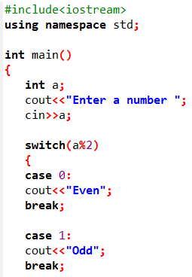

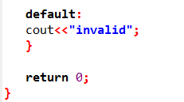
Example
Output

Slide 14
Switch Statement
Without break what will happen:
Do not forget to use a break statement when necessary. Once a case is matched, the statements starting from the matched case are executed until a break statement or the end of the switch statement is reached. This is called fall-through behavior

Slide 15
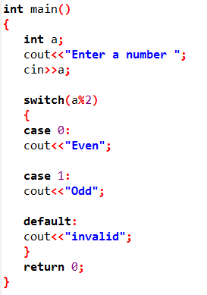

What is the output?
Output:

Slide 16
Activity
Write a C++ program to check whether a character is vowel or consonant.

Slide 17
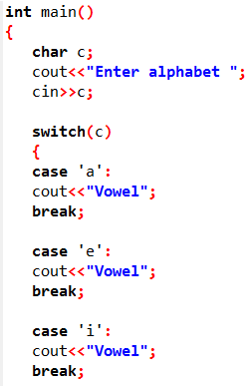
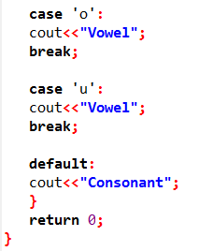


Issue:
Output:

Slide 18
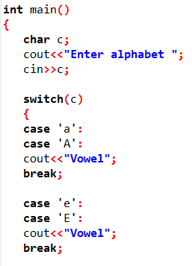
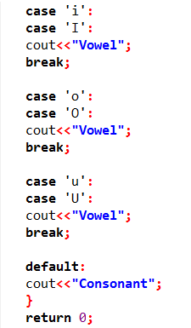

Output

